Slide 1
NittFlix Analysis
Digital Media Analytics I
Madalyn Lovejoy

Slide 2
Main Objectives
Drive new subscription orders to the streaming service
Engage existing subscribers with the service's shows and content

Slide 3
Key Performance
Indicators
Analyze frequently used acquisition channels of new subscribers and determine which highly utilized channels to prioritize in 2027
Increase the average number of incoming subscribers to 300 new users each month through email marketing campaigns
By January 2027, increase email click-through rates to 25% by crafting messages with personalized subject lines that appeal to users' interests

Slide 4
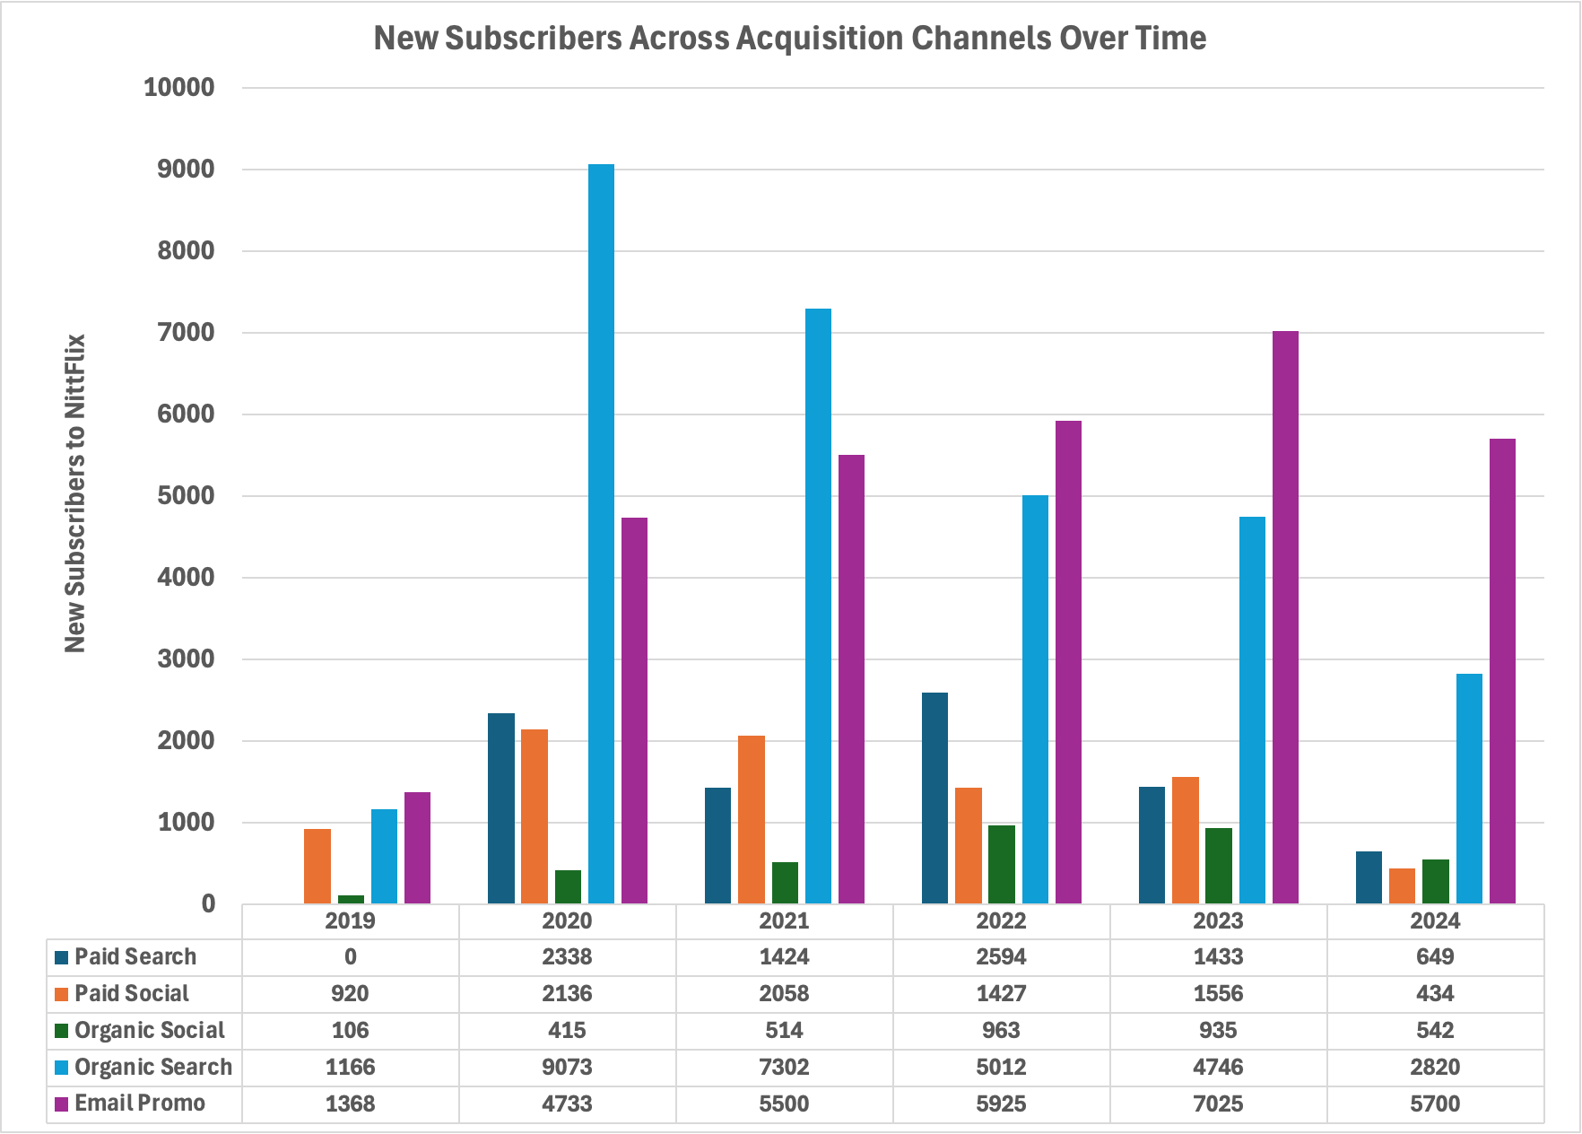
Analyze Acquisition Channel Utilization
New subscriber data was analyzed to reveal trends in acquisition channel utilization. The data suggests that users primarily originate from Organic Search and Email Promo channels.
Prioritizing time, energy, and funds to Organic Search and Email Promo channels could further increase the number of subscription orders NittFlix sees in the next year.
Eliminating or reducing time spent on channels that are less commonly used, such as Organic Social, could provide more capacity to develop marketing for highly utilized channels.

Slide 5
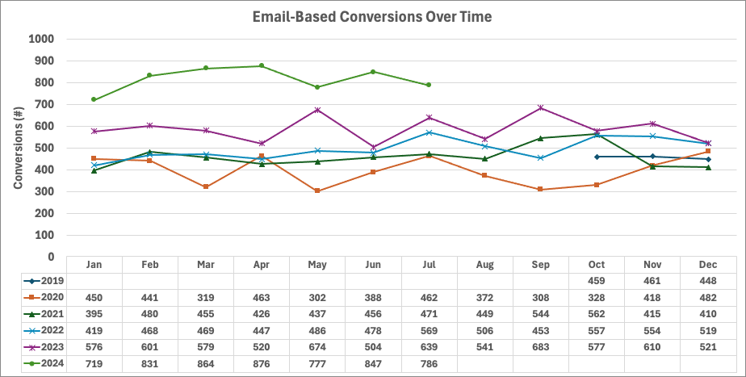
Increase Subscribers Through Email Campaigns
  In 2024, email campaign data shows that monthly conversion totals have increased compared to data from previous years. The average monthly increase in conversions was 230.
  Raising the average number of conversions to 300 new subscribers each month will support a larger user base on NittFlix's platform.
  Seeking out email addresses from untapped demographics could be helpful in increasing subscription orders.

Slide 6
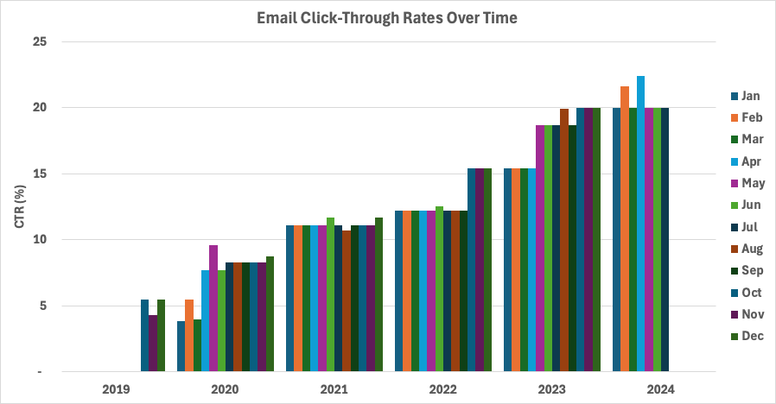
Increase Click-Through Rates Through Personalized Email Messaging
  After analyzing campaign performance metrics, the data suggests that email open rates (Click-Through Rates) have been on the rise since 2019. During the first half of 2024, we can see that the Click-Through Rates are consistently at or above 20% each month.
  Working towards an average open rate of 25% will support our work in engaging existing subscribers in NittFlix's shows and content.
  Experimenting with personalized subject lines that are tailored to a given user's interests could further increase opened emails and content engagement.

Slide 7
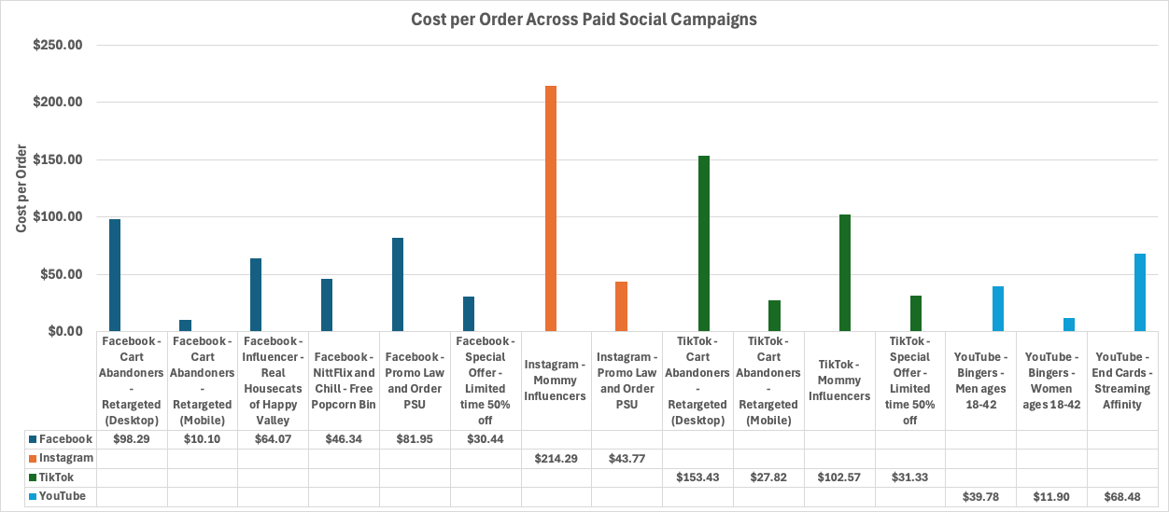
Analyze Paid Social Media Costs
In reviewing NittFlix's paid social media data, it appears that YouTube and Facebook campaigns are performing under the Cost per Order (CPA) limit more consistently than other campaigns. TikTok and Instagram campaigns occasionally perform below the limit, with some campaigns performing better than others.
With NittFlix's $70 CPA target in mind, some campaigns that could be cut are 'Mommy Influencers' on TikTok and Instagram, 'Cart Abandoners...Desktop' on TikTok and Facebook, and 'Promo Law and Order PSU' on Facebook.
The campaigns that exceed the $70 limit are often tailored to desktop users, which may impact consumer access to the media. Most people are on their phones, away from home. Adapting these campaigns to cheaper mobile platforms could lead to a CPA within the target.
Other campaigns that seemed less effective centered around specific demographics ('Mommy Influencers') or promoted more mature shows ('Promo Law and Order PSU'). Keeping content light and generalizable could appeal to greater audiences.

Slide 8
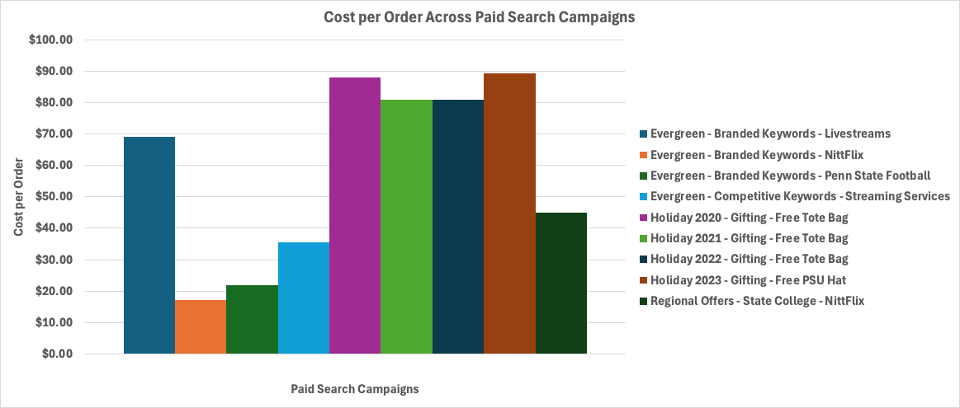
Analyze Paid Search Costs
Analysis of NittFlix's paid search campaigns suggest that the 'Evergreen' and 'Regional Offers' campaigns are performing under the Cost per Order (CPA) limit. The 'Holiday' campaign has exceeded the $70 limit from 2020-2023.
With the CPA target in mind, NittFlix could adjust the 'Holiday' campaign's budget appropriately and develop new, engaging content that leads to more prospective users placing a subscription order. These suggestions could lead to a 'Holiday' CPA below the $70 threshold.
The 'Holiday' campaigns exceeded the $70 limit because, unlike other campaigns, NittFlix used its budget to gift a free tote bag to new subscribers. No other campaigns offered a tote bag as an incentive, so the costs to maintain this campaign outweighed any profits that could be made through new subscribers.
Researching incentives at a variety of price points or developing an entirely new 'Holiday' campaign could lead to a more cost-effective campaign that is still full of festive cheer.

Slide 9
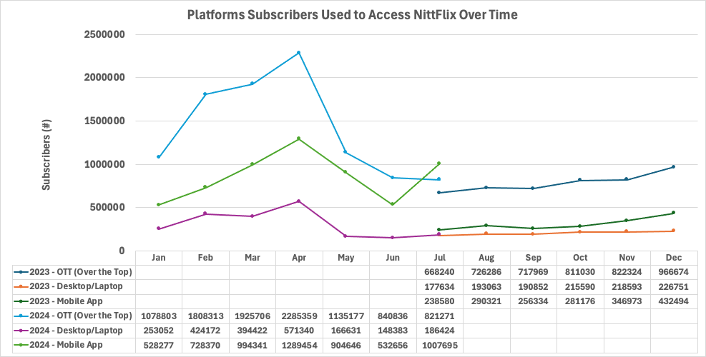
Analyze User Platform Trends
Between July 2023 and June 2024, NittFlix users accessed the streaming service through a variety of platforms. While all platforms showed an increase in new subscribers in 2024, certain platforms were utilized more often than others. Over the Top (OTT) platforms were most commonly used by new subscribers, while Desktop/Laptop platforms were used the least.
There was a drastic increase between 2023 and 2024 platform utilization. Looking at the OTT data, you can see that the number of new subscribers in July 2023 was 668,240. There were increases to 811,030 in October 2023 and 1,078,803 in January 2024, but the number of new subscribers to the platform skyrocketed to 2,285,359 in April 2024.
There was a 21% increase in OTT subscribers between July and October, and a 33% increase from October to January. There was a 112% increase in subscribers between January and April, which can be further analyzed with user streaming trends.

Slide 10
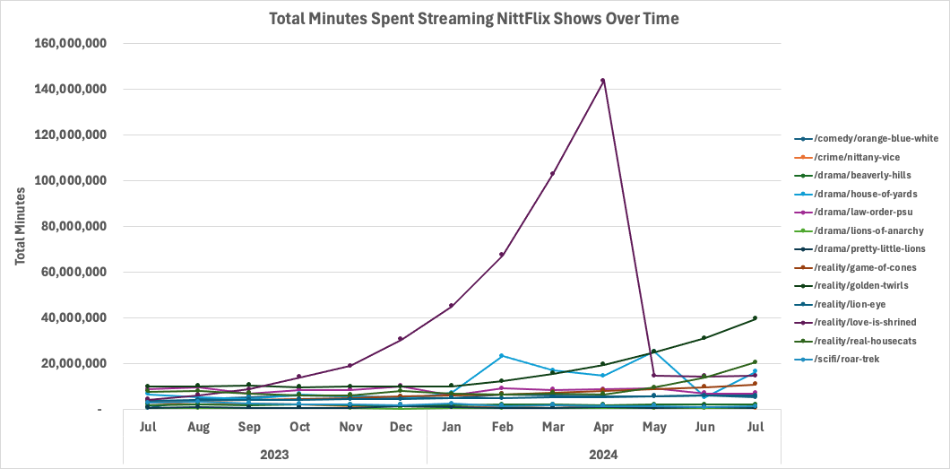
Analyze User Streaming Trends
NittFlix users' total time spent streaming a given show is typically less than 40,000,000 minutes, but one major outlier can be seen in the graph below. One show that had a major increase and steep decrease in watch time was the reality show, Love is Shrined. The monthly watch time peaked at 143,568,865 minutes in April and fell to 14,591,088 minutes the next month.
Despite the drastic change in Love is Shrined's watch time, reality show watch times are generally increasing, with more minutes streamed for newer shows. Dramas are either maintaining or losing minutes streamed. Crime show streaming has also decreased throughout the year. SciFi show watch time is inconsistent from one month to the next. Comedy streaming times initially showed an increase, then remained steady over time.
Reality shows have the highest streaming times at 14,701,999 minutes on average. The lowest streaming times belong to crime shows with 1,354,216 minutes on average.

Slide 11
Key Takeaways & Recommendations
NittFlix has achieved impressive successes over the past few years. With the recommendations below, NittFlix can continue to increase their position as a popular and highly used streaming service.
One recommendation is to conduct A/B testing to increase email click-through rates. NittFlix can develop standardized (control) and personalized (test) email subject lines to determine if subscriber behavior changes when exposed to standardized subject lines compared to more personalized subject lines that appeal to their interests and watch history. This test would reveal if subscribers engage more with standardized or personalized messaging, which would inform future email marketing tactics.
A second recommendation is to review the budget and determine which channels and platforms should be prioritized when planning marketing materials and campaigns for the next year.
Another recommendation is to reduce excessive campaign costs by developing paid social media content that is appealing to wider audiences across multiple platforms and selecting subscription incentives that are cheaper to produce than current items offered.
Finally, developing engaging marketing for highly streamed shows and adding new shows from popular genres to the streaming service would increase subscriber engagement with the platform.
Their objectives of increasing the number of new subscription orders and improving upon existing subscribers' engagement with the streaming service area are achievable with some adaptations to their current approach.

Slide 12
Thank you.

